Slide 1
Photomicrographs of Plant foods
Spinach
Permission to reproduce original photomicrographs used to make this collection may be obtained from
Dr. David O. Norris at
david.norris@colorado.edu

Slide 2
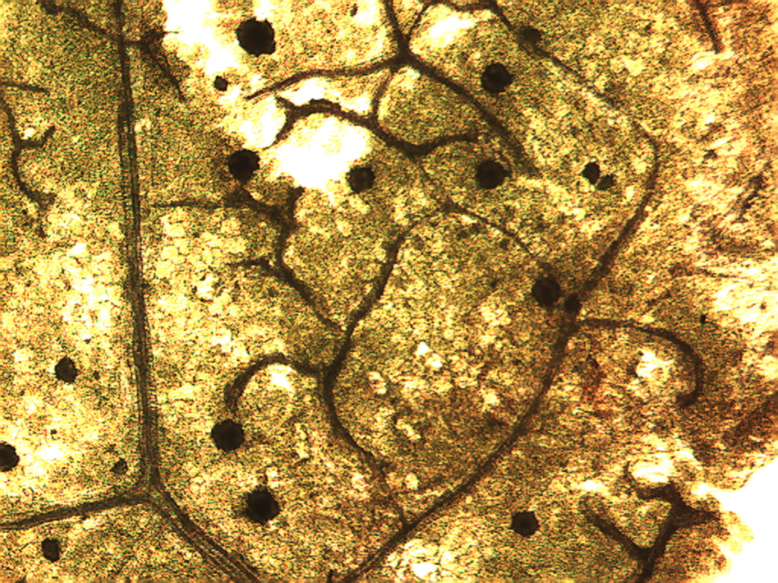
Notes:
448. Spinacia oleracea L. Spinach. Leaf surface showing druse crystals (white arrows) and veins composed of vascular tissue (black arrows), 4X.

Slide 3
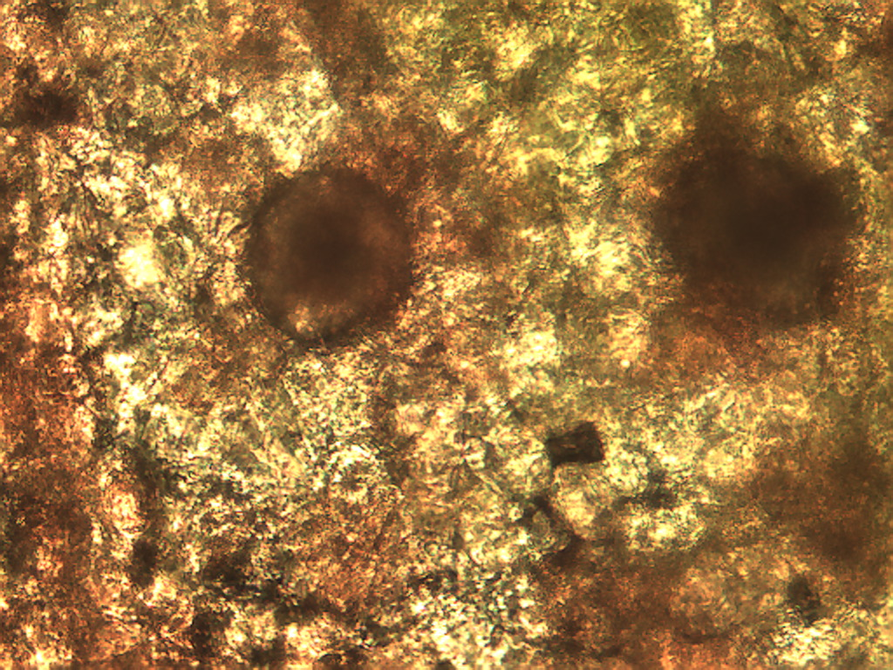
Notes:
449. Spinach. Druse crystals in leaf (arrows), stained with safranin, 25X.

Slide 4
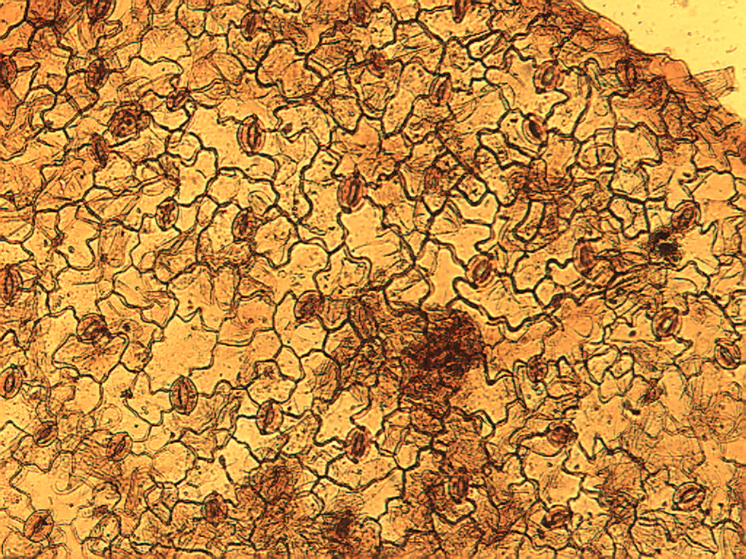
Notes:
450. Spinach. Leaf epidermis with many stomates (arrows), 10X.Compare to parsley and lettuce.

Slide 5
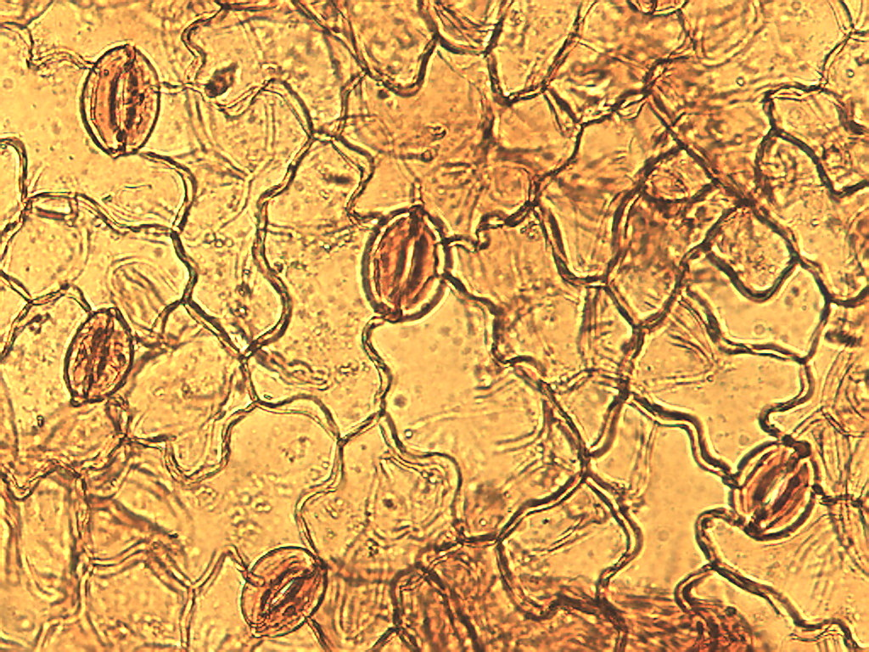
Notes:
451. Spinach, Leaf epidermis, stained with safranin, 25X Stomates (arrows).

Slide 6
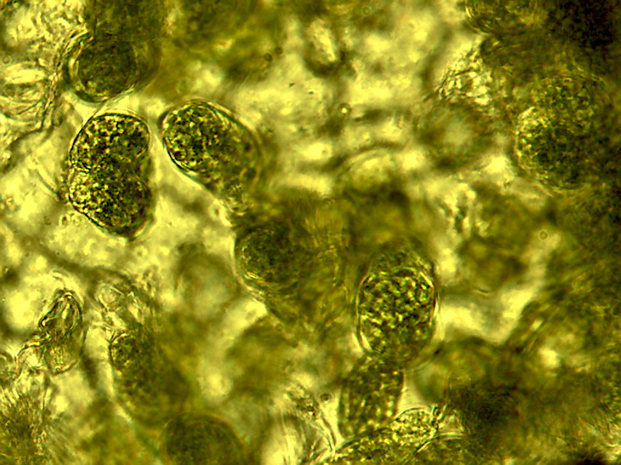
Notes:
452. Spinach. Leaf photosynthetic cells adhering to epidermal cells (background), 25X.

Slide 7
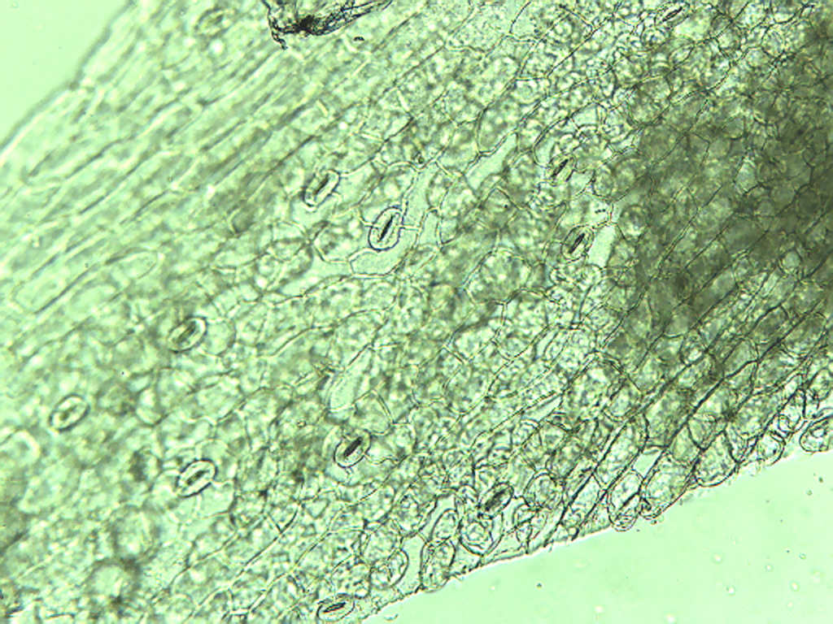
Notes:
453. Spinach. Petiole epidermis with stomates (arrows), 10X.

Slide 8
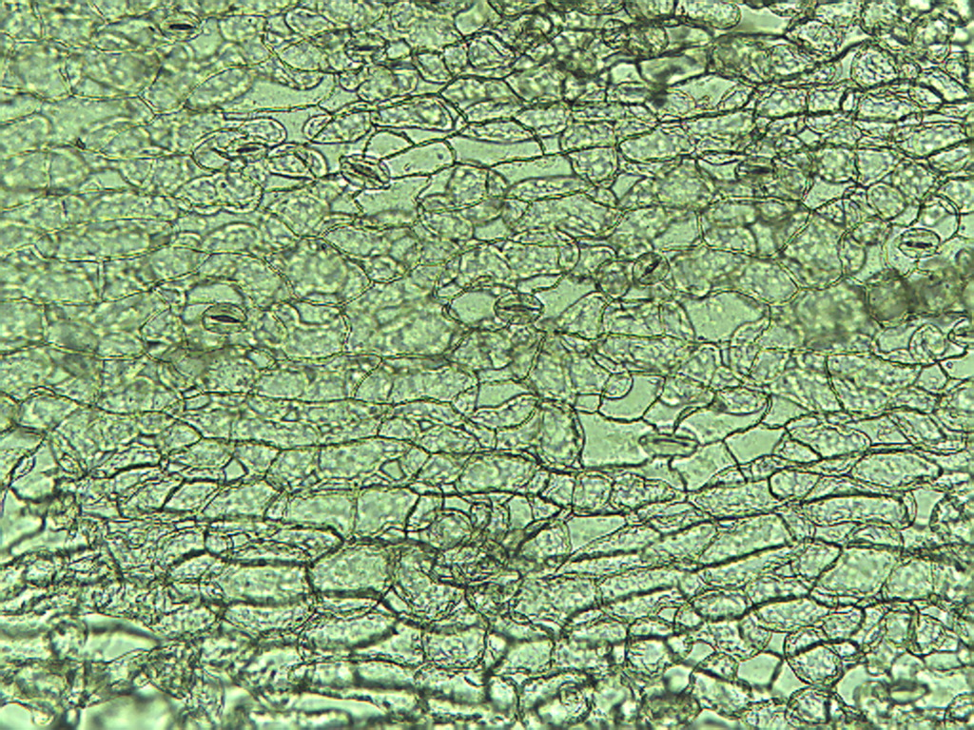
Notes:
454. Spinach. Petiole epidermis, 10X.

Slide 9
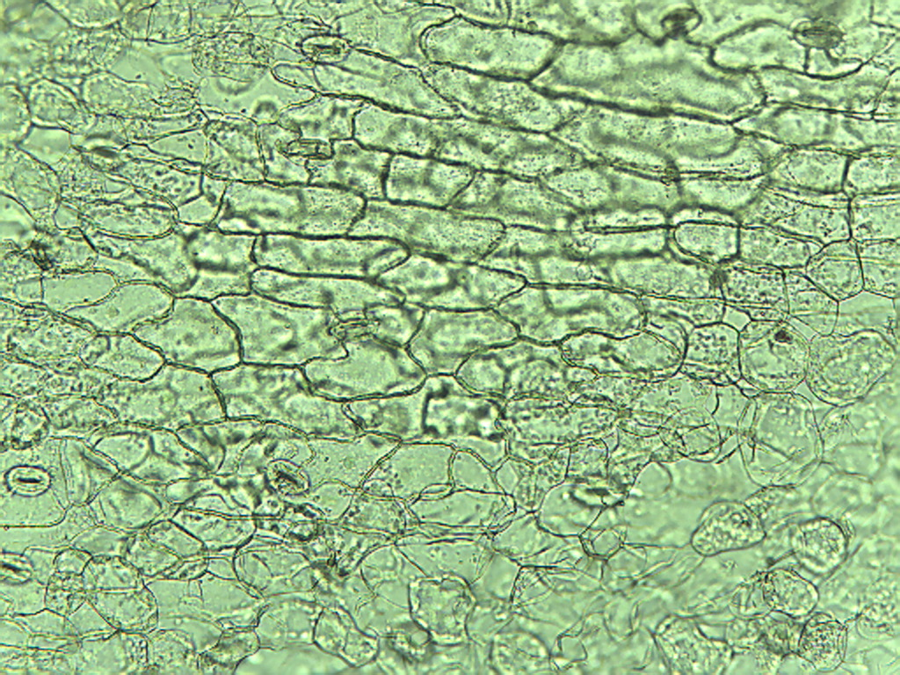
Notes:
455. Spinach. Petiole epidermis, 10X.

Slide 10
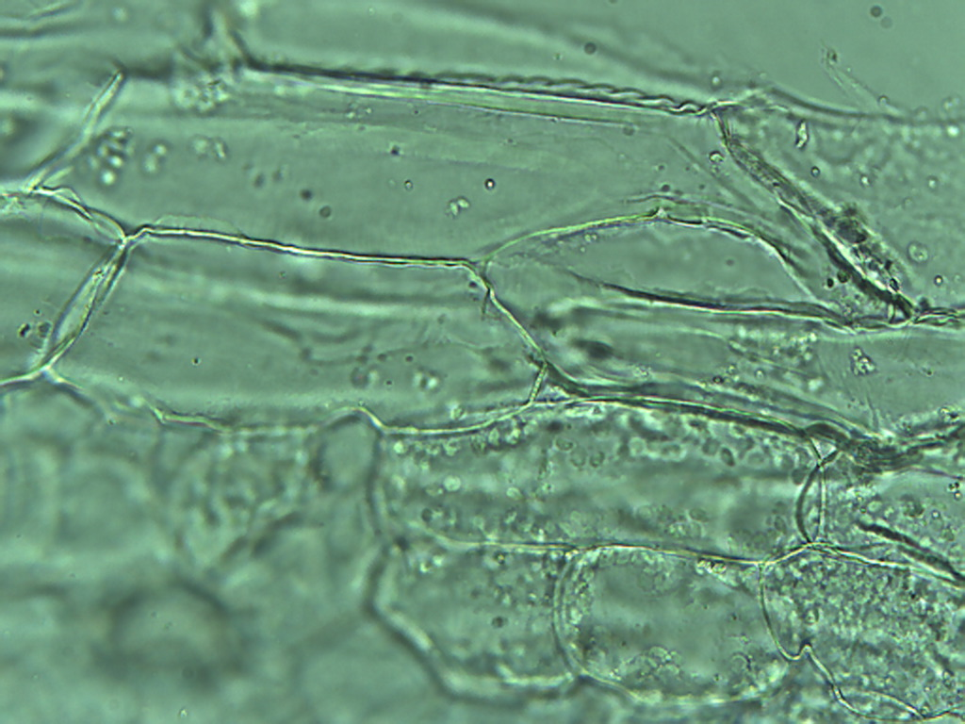
Notes:
456. Spinach. Petiole epidermis, 25X.

Slide 11
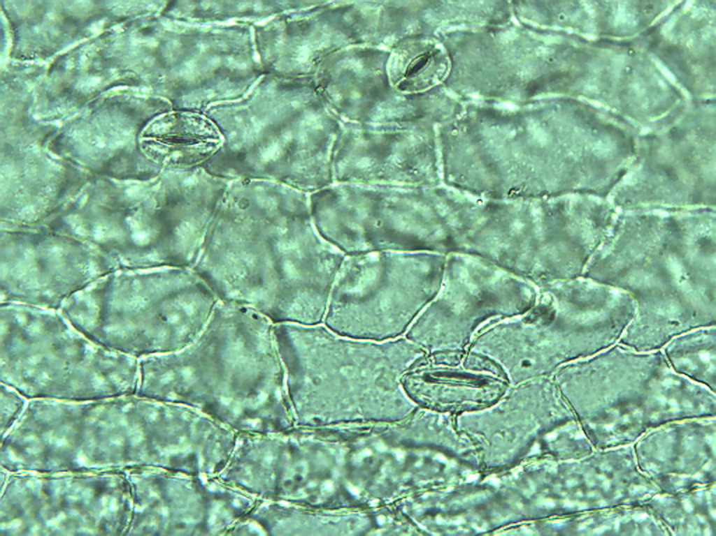
Notes:
457. Spinach. Petiole epidermal stomates (arrows), 25X.

Slide 12
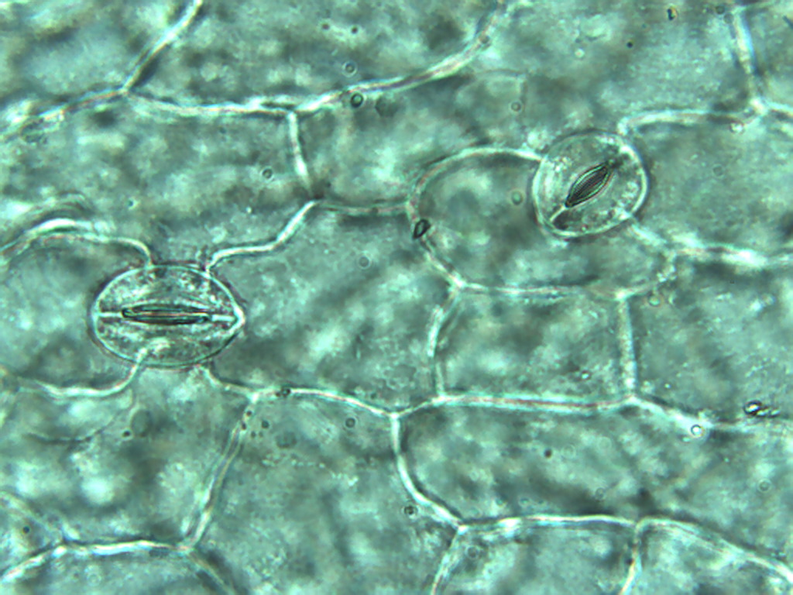
Notes:
458. Spinach. Petiole epidermis with stomates (arrows), 40X

